Slide 1


Slide 2

Learning Objectives
Learn how to make a website using HTML, CSS, and Javascript
Learn key principles that make a website “beautiful”
Meet and share passion with other students interested in web design

Slide 3

Instructors
Shawn Park
Design Section
3rd Year Computer Science Major
From Ulsan, Korea
Interests: UI Design and Entrepreneurship
Hobbies: League of Legends & Kpop
Currently working on a startup Iris

Slide 4

UI Design Workflow
UC Berkeley CET

Slide 5

UI Design Workflow
Free Ventures

Slide 6
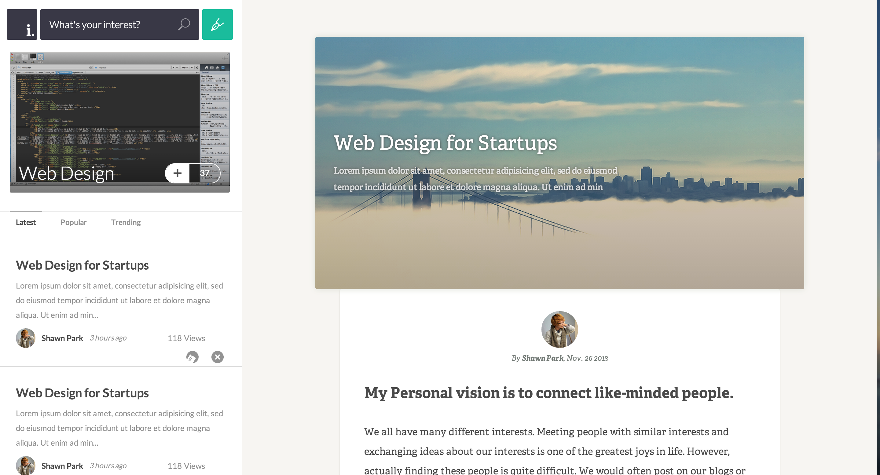
UI Design Workflow
Iris: A community for your interests

Slide 7

Instructors
Jeff Zhan
Programming Section
4th Year EECS Major
From Columbus, OH
Interests: Graphic Design and Web Dev
Hobbies: Working out, Drawing, Traveling
Worked at CloverInk and TubeMogul

Slide 8
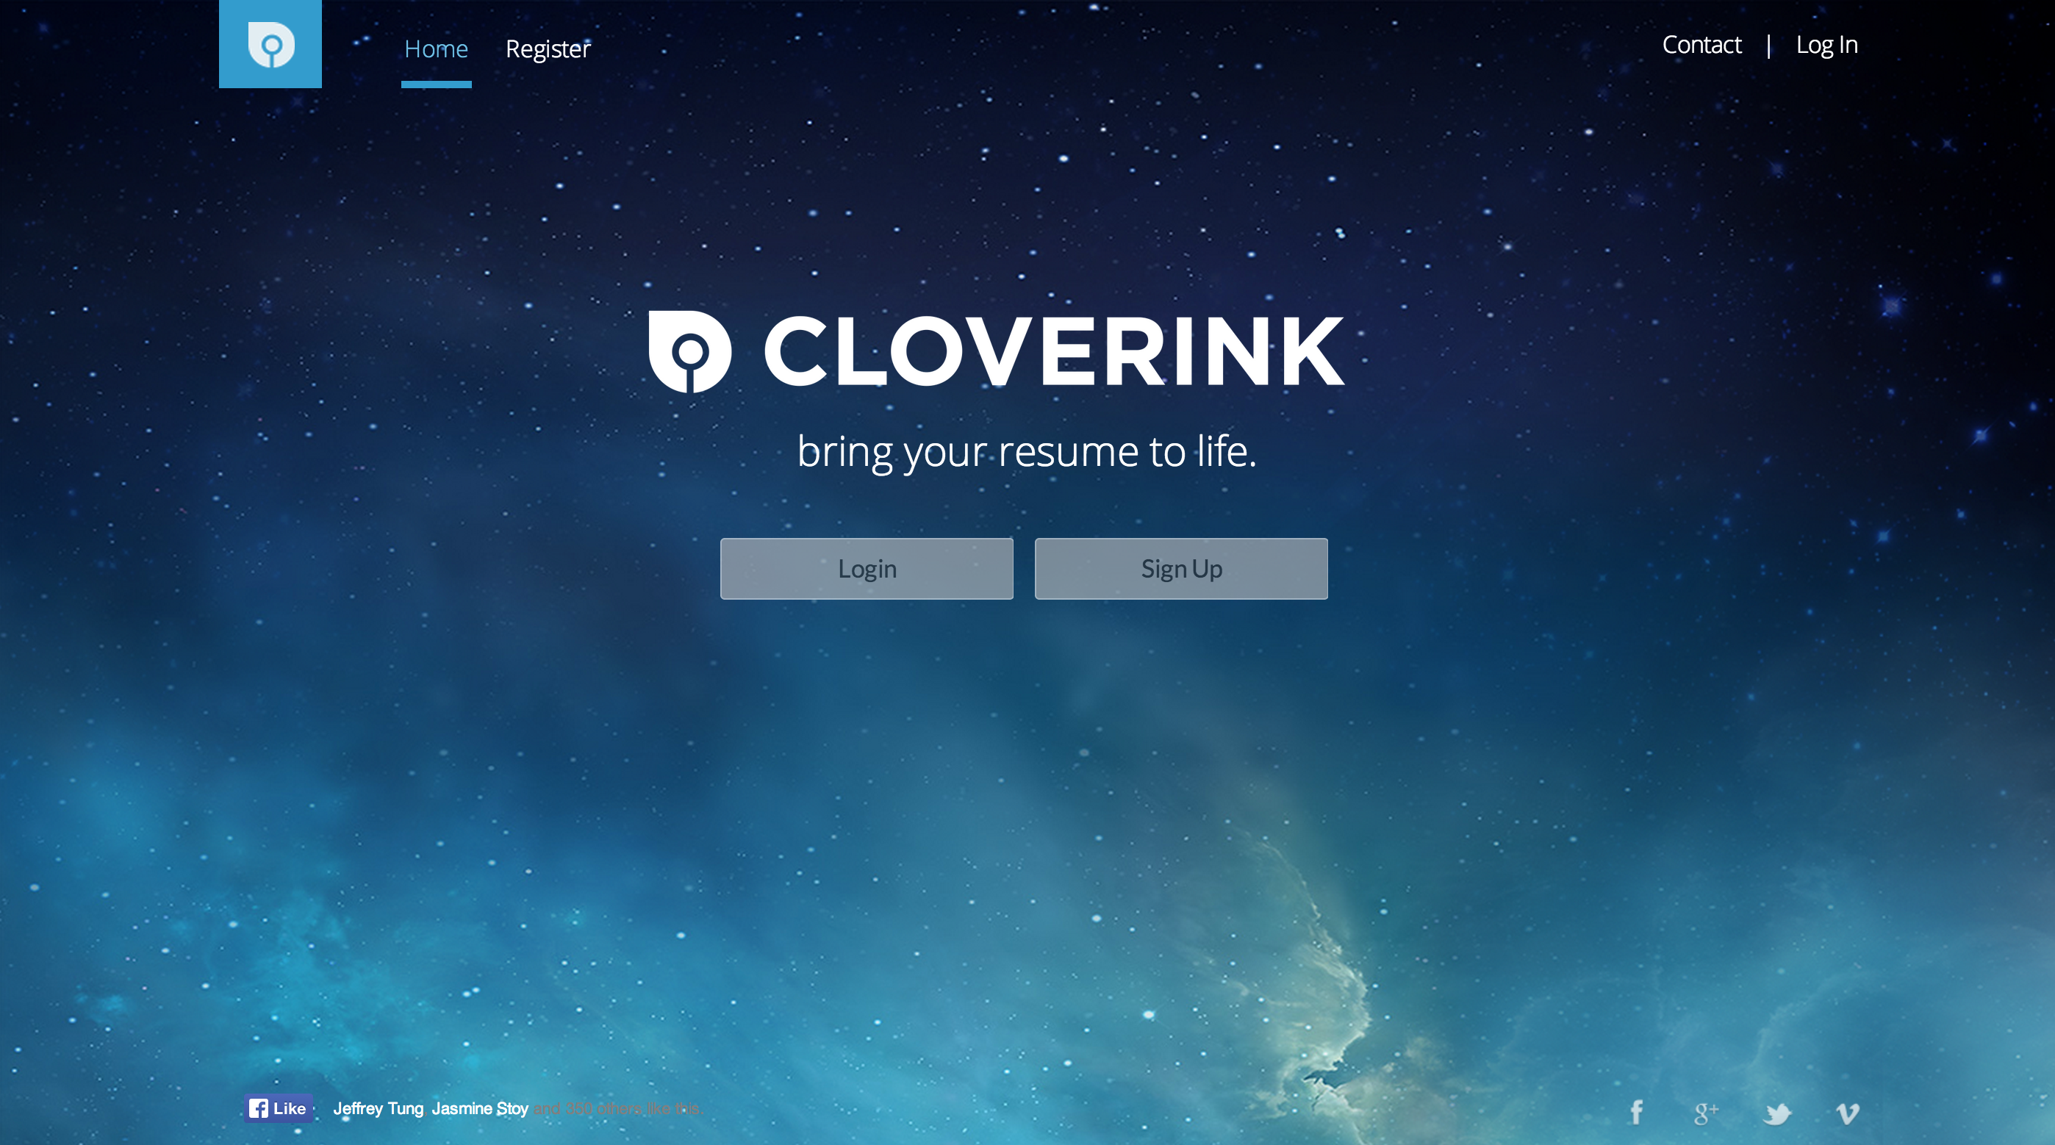
UI Design Workflow
Cloverink

Slide 9



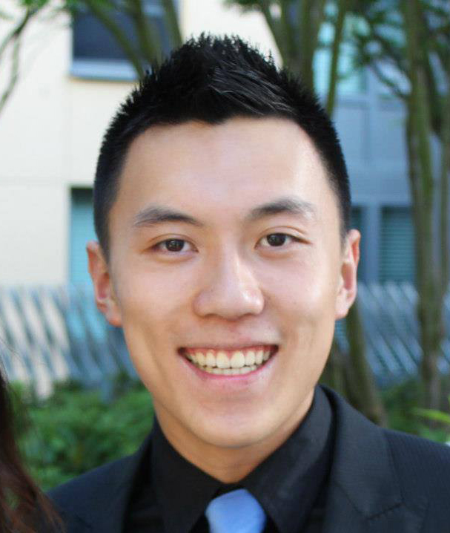

Teaching Assistants
Adam Sebti
Andy Qin
Ingrid Hong
Philip Su
Sarah Kim

Slide 10
Class Logistics
Tuesday 7P– 9P @ 60 Evans
7P – 8P: Programming Section
8P – 9P: Design Section
The order is reversed for first two weeks only
Programming Section: Learn how to make a website
Design Section: Learn how to make a website beautiful
2 Units DeCal: P/NP
Lower division and Upper division credits offered

Slide 11
Grading
You must earn above 70 in order to receive a passing grade.
You will lose 5 points from total grade for each missing attendance

Slide 12
Need Help?
Ask questions on Piazza
CS 98/198 – 32: Web Design DeCal
We will try to answer your questions within 24 hours
Please screenshots of the web page so that we can understand your problem better
Please do NOT post screenshots or snippets of actual code
Office Hours (yes, office hours for a DeCal)
2 – 4PM @ Free Speech Movement Café (next to Moffitt)

Slide 13
Class Timeline: Programming
Week 1-2
HTML Basics
Week 2 - 5
CSS
Week 6 – 10
Javascript and Jquery
Week 11
Extra Topic

Slide 14
Class Timeline: Design
Week 1-2
Introduction
Week 3 - 6
UI Aesthetics
Week 7 - 10
UI Experience
Week 11
Extra Topic

Slide 15
Questions?

Slide 16
Why learn Web Design?
So many use cases
Personal Portfolio
Web Application
Event Promotion
Essentially your online identity
Best place to start learning programming & design
Low barrier to entry compared to other programming languages
Quick to implement & iterate in terms of design
Design = First Impression

Slide 17
What is a Web Site?
A set of web pages served from a single domain
A web page is a document, usually in HTML files
A domain is an address (http://www.thewebdesignworkshop.co) that represents a server where the files are located.

Slide 18
Server
File
Browser
How Websites are shown
Example: http://www.thewebdesignworkshop.co
1. A user types in the address (http://www.thewebdesignworkshop.co)
2. The browser looks up the address, which points to a server somewhere in the world. (In this case, we use a WebFaction server located in Los Angeles, CA.)
3. The browser loads all of the required file: an HTML file might (usually) require more than one files.

Slide 19
Getting a Server to host your web pages
Technically, your computer can be a web server.
Ex.: Designate a folder to be accessible by the public
Why Not? 1. Security 2. Consistency
Preferred Solution: Get a web hosting service (Ex. WebFaction, AWS)
Web Hosting Service provides you with a “space” within their server that you can use.
For this class, you can simply develop on your computer without a server (Development on Local)

Slide 20
What Websites are made of
Front-end
What users can “see”
Back-end
What users can’t “see”
Ex. Buttons, Images, Text
Ex. Algorithms behind Logins, Search, etc.

Slide 21
What Websites are made of
HTML
Structure
= Skeleton
CSS
Design
= Clothes
Javascript
Function
= Muscle

Slide 22
HTML provides the structure of a page
A well-written HTML document should be “understandable” without a stylesheet.

Slide 23
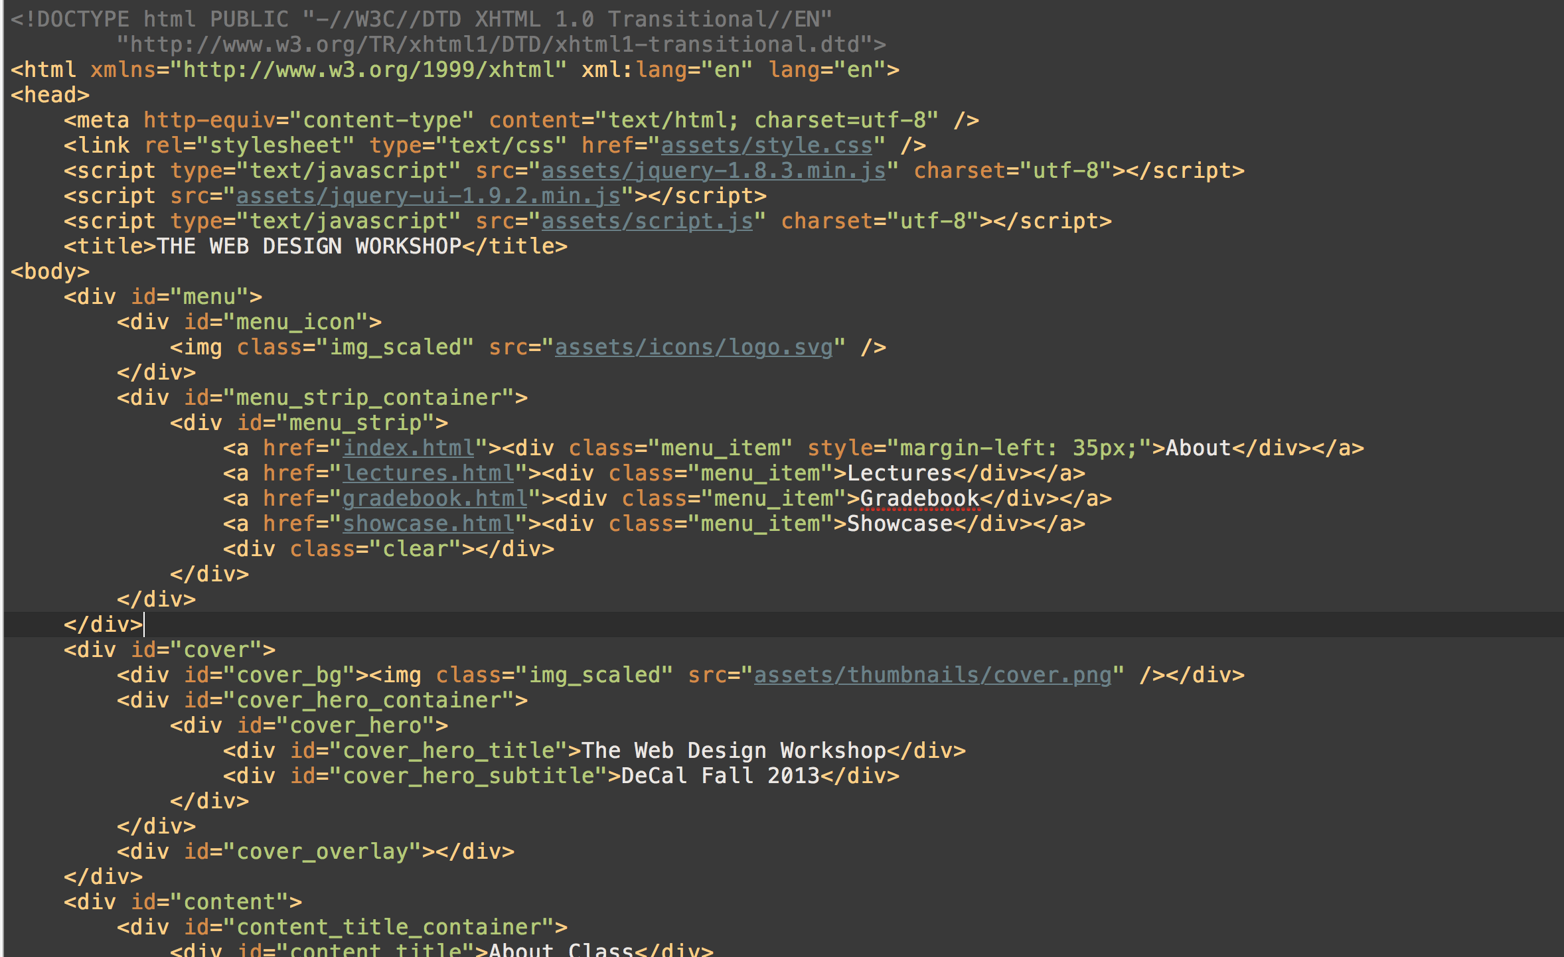

Slide 24
CSS provides the design of a page
Just several lines of “code” is enough to create “design” – shapes, color, buttons, you name it.

Slide 25
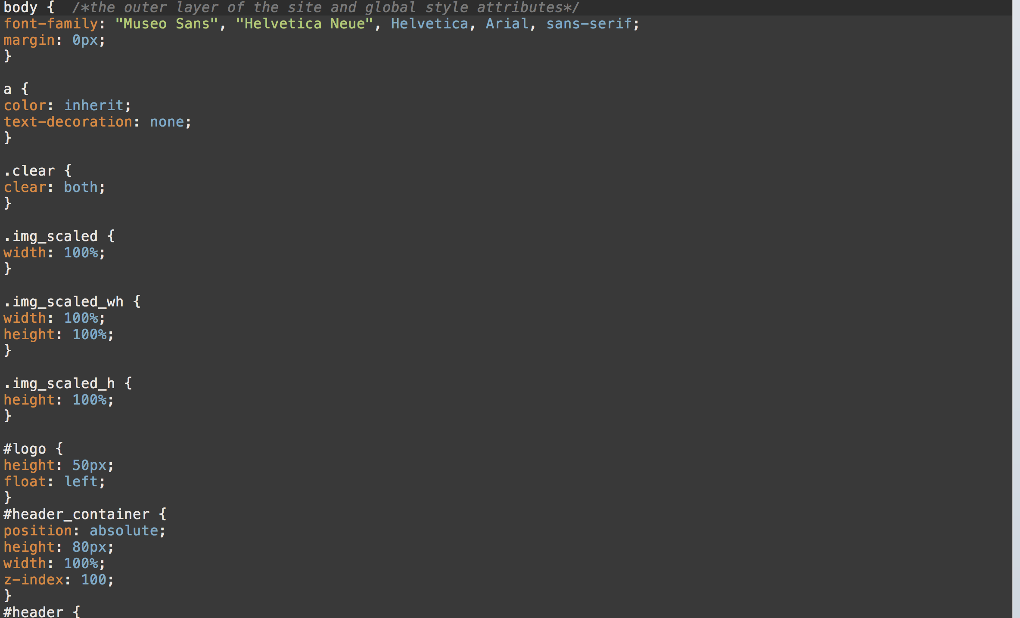

Slide 26
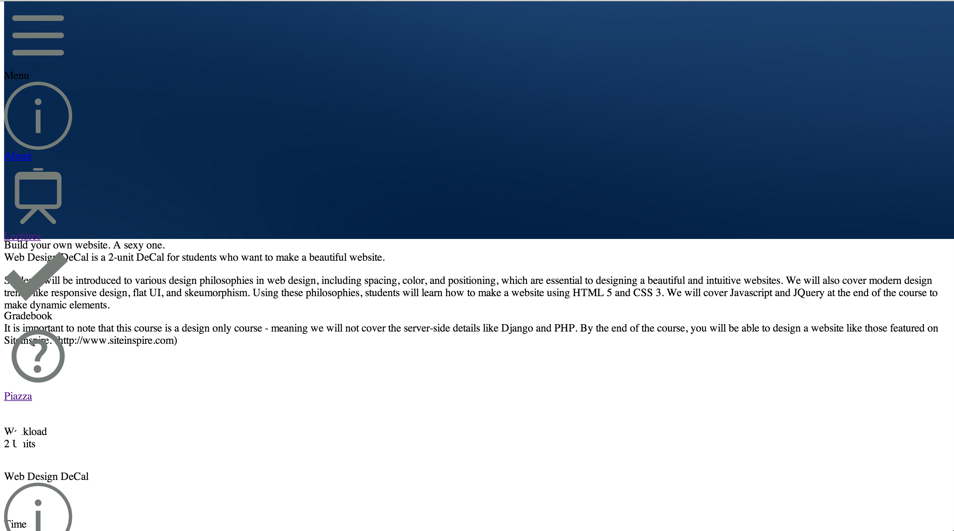

Slide 27
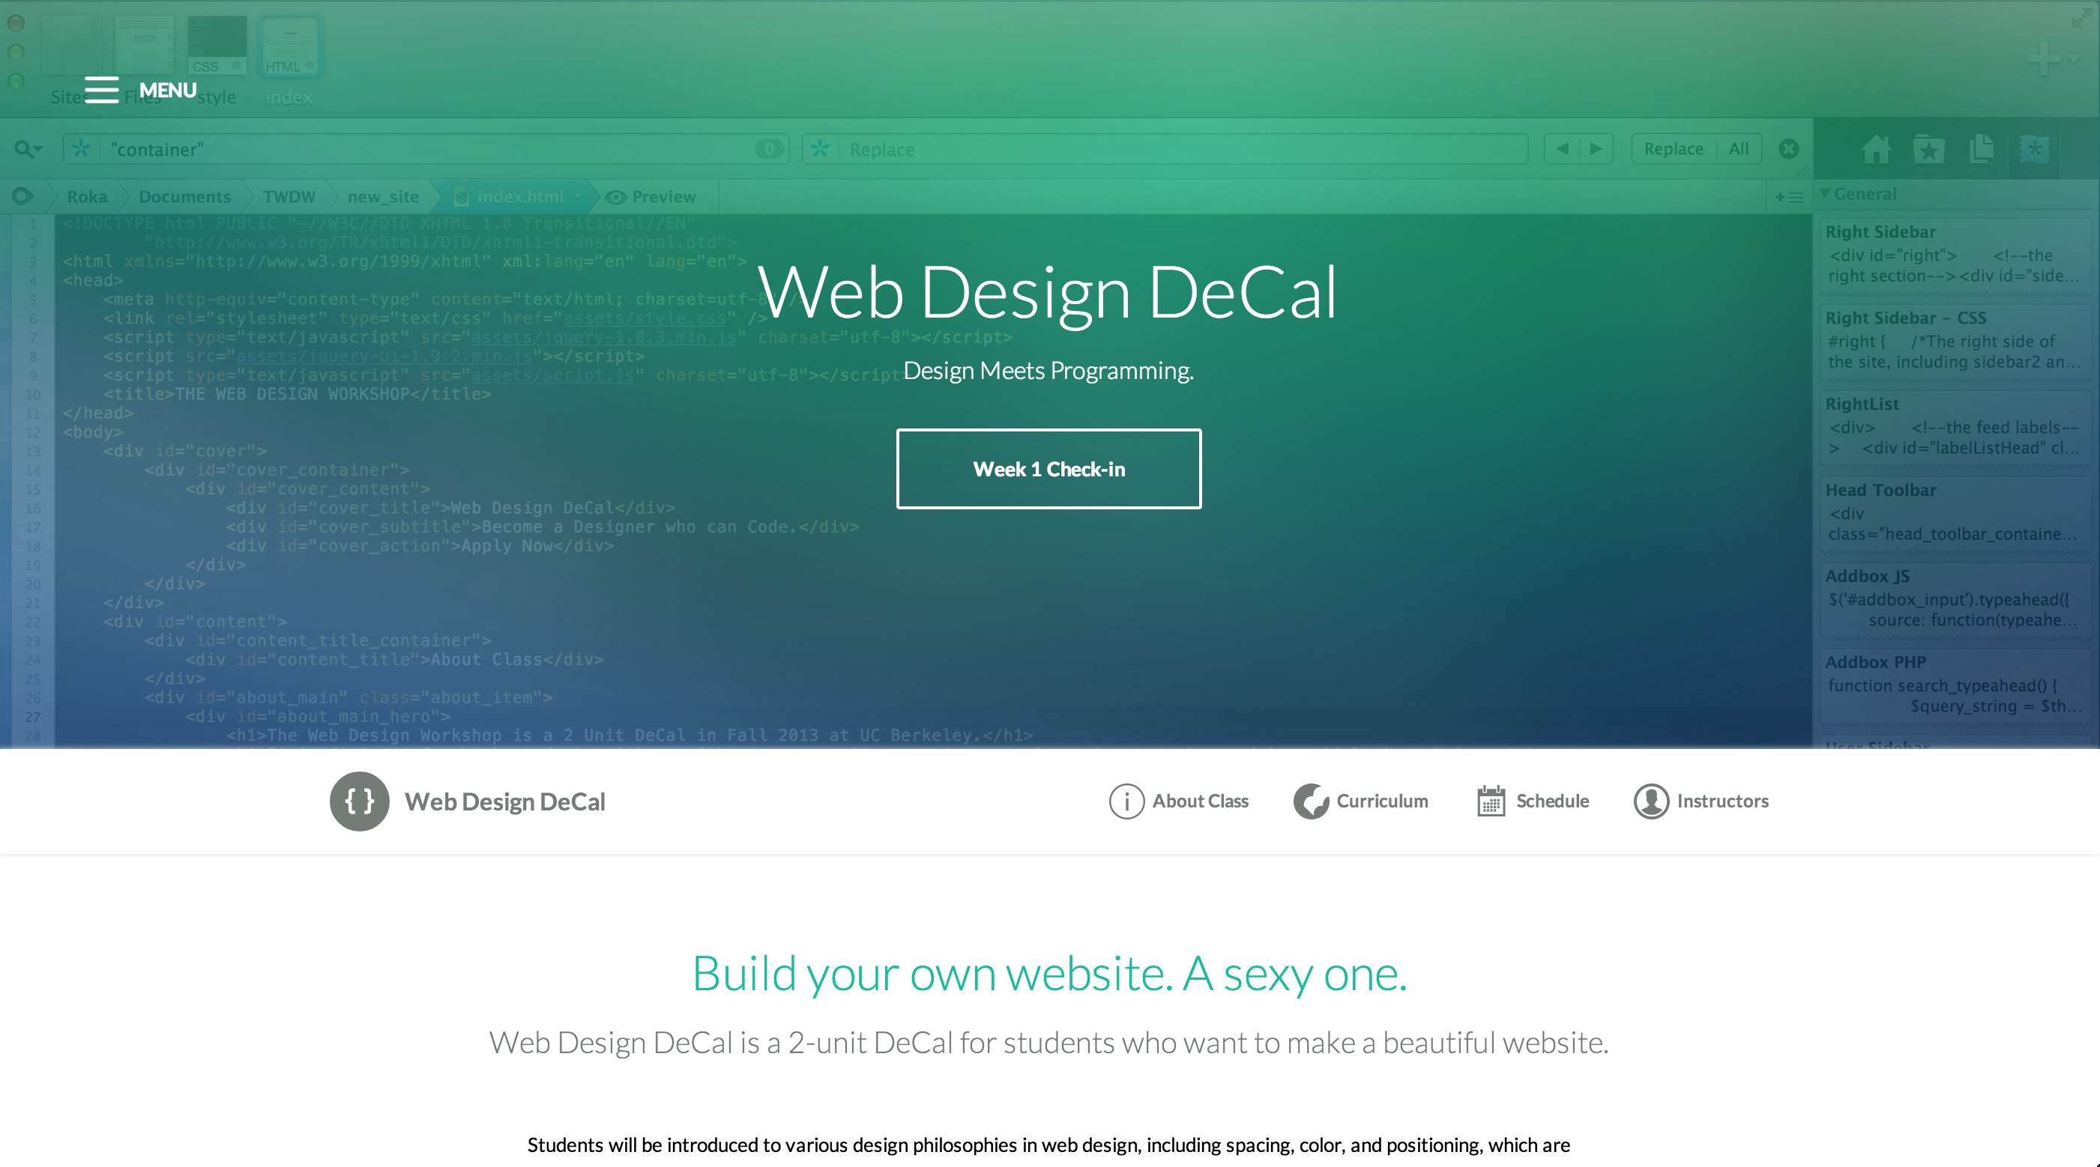

Slide 28
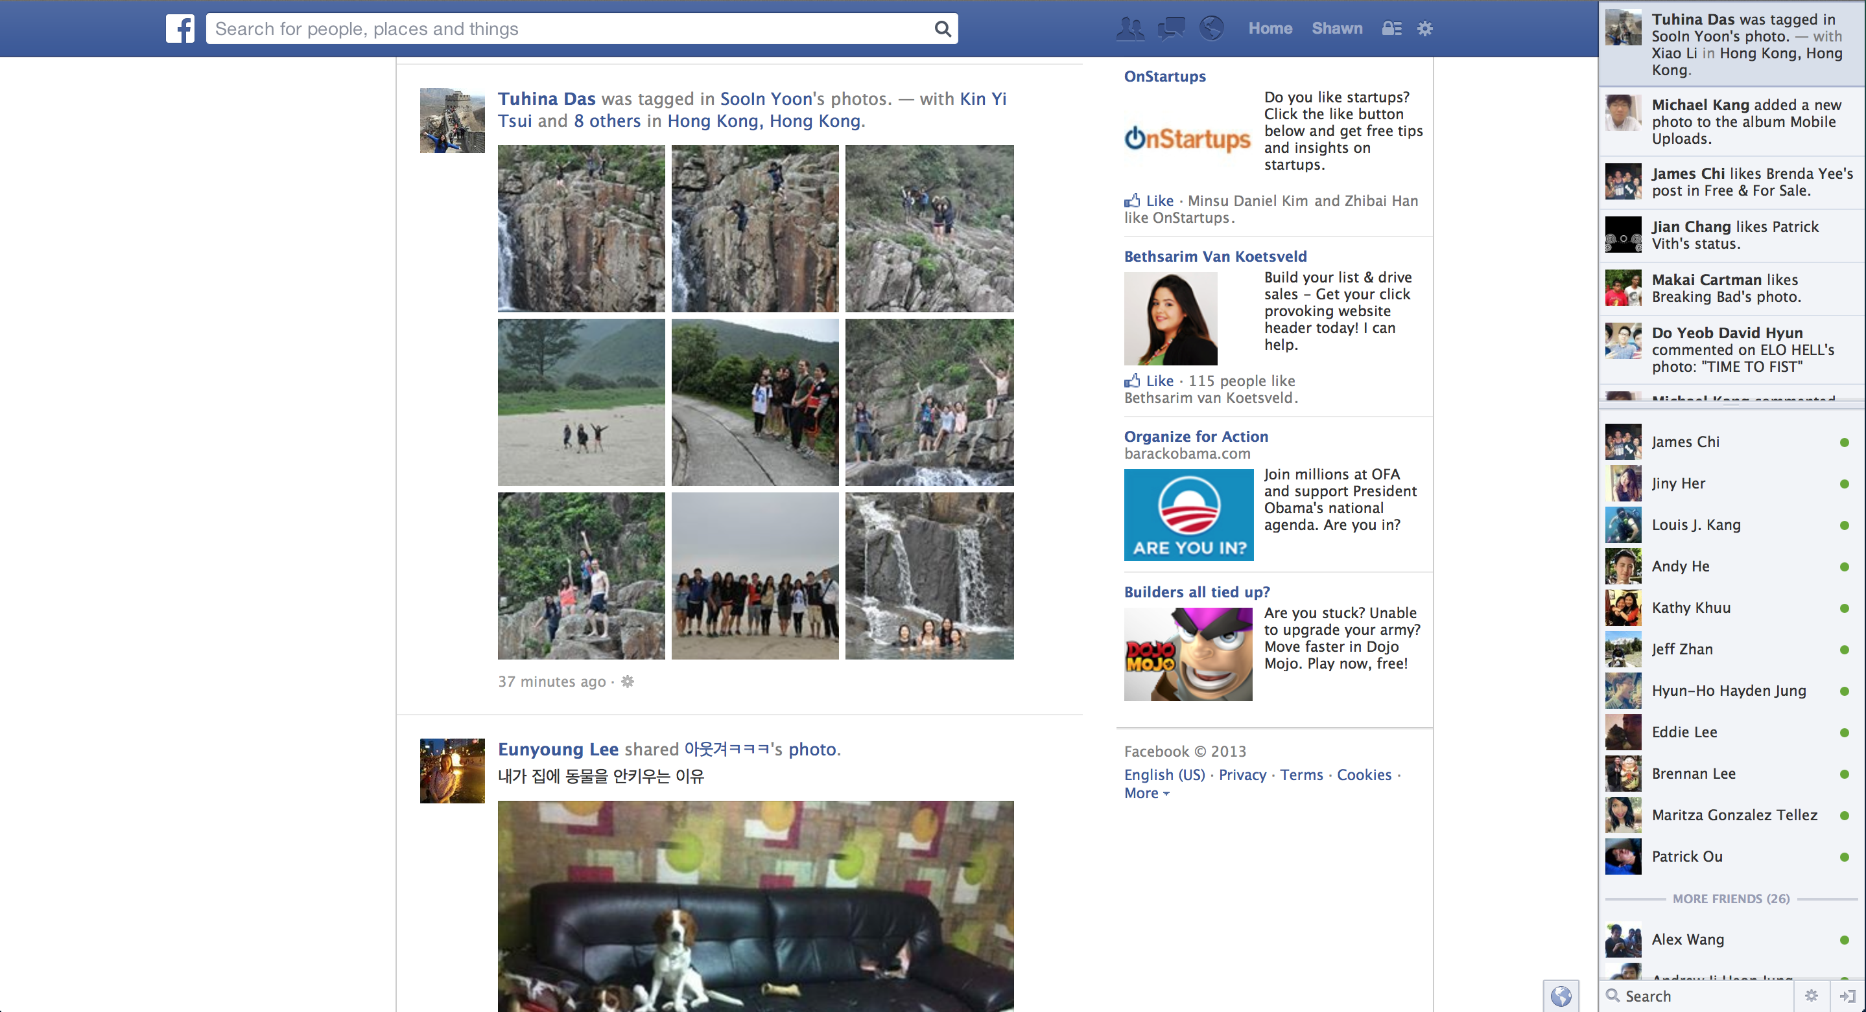

Slide 29
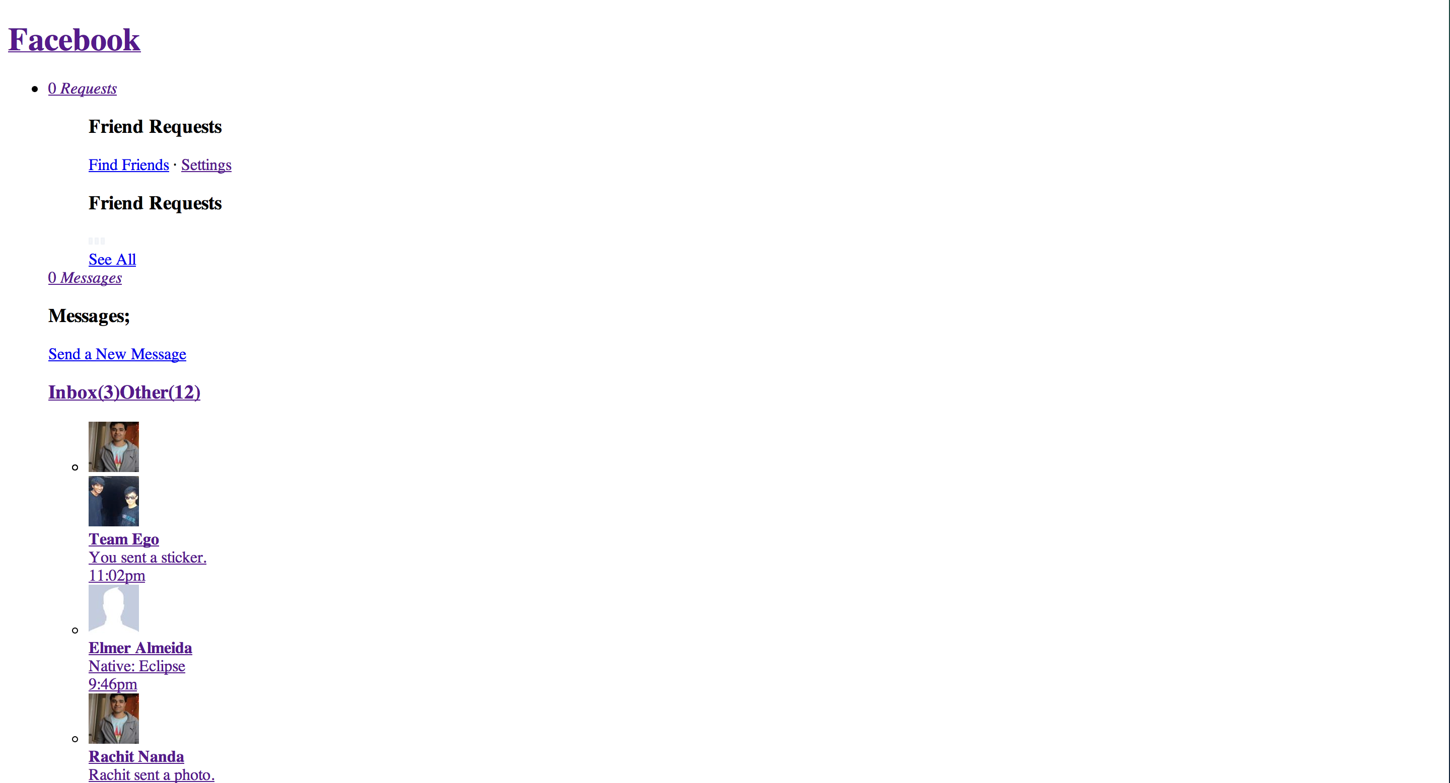

Slide 30
JS provides the function of a page
What will happen to the website with Javascript disabled?

Slide 31
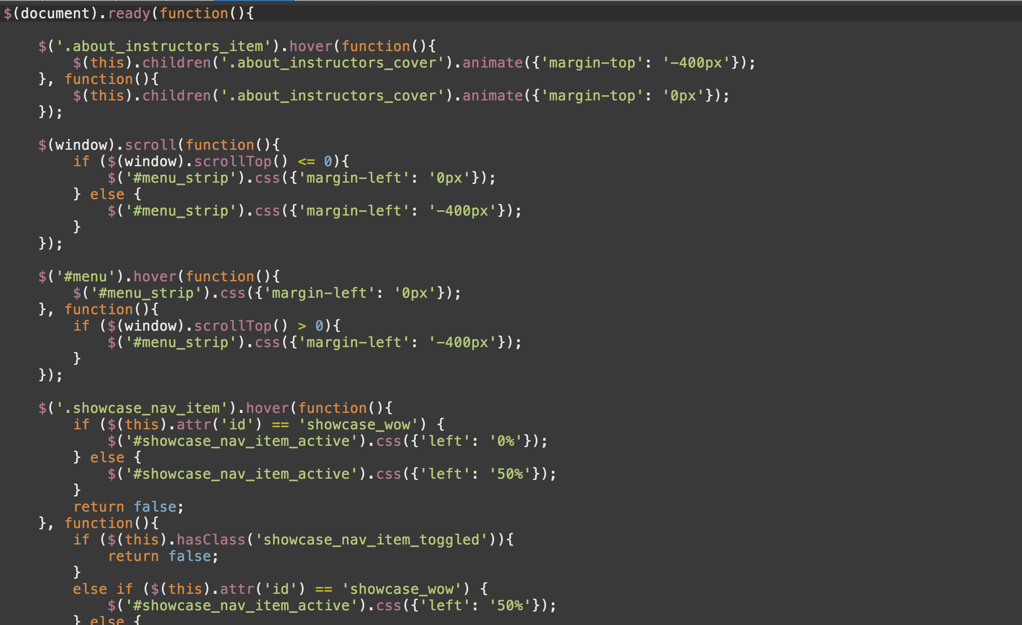

Slide 32
How do I make a Website?
Web Browser
Chrome
Firefox
Code Editor
Coda 2
Sublime Text
Image Editor (Optional)
Adobe Photoshop
Safari
Dreamweaver

Slide 33
UI Design Workflow
HTML
Code up the structure in a code editor
CSS
Stylize the website using the Web Inspector
JS
Add the missing functionality in the code editor

Slide 34
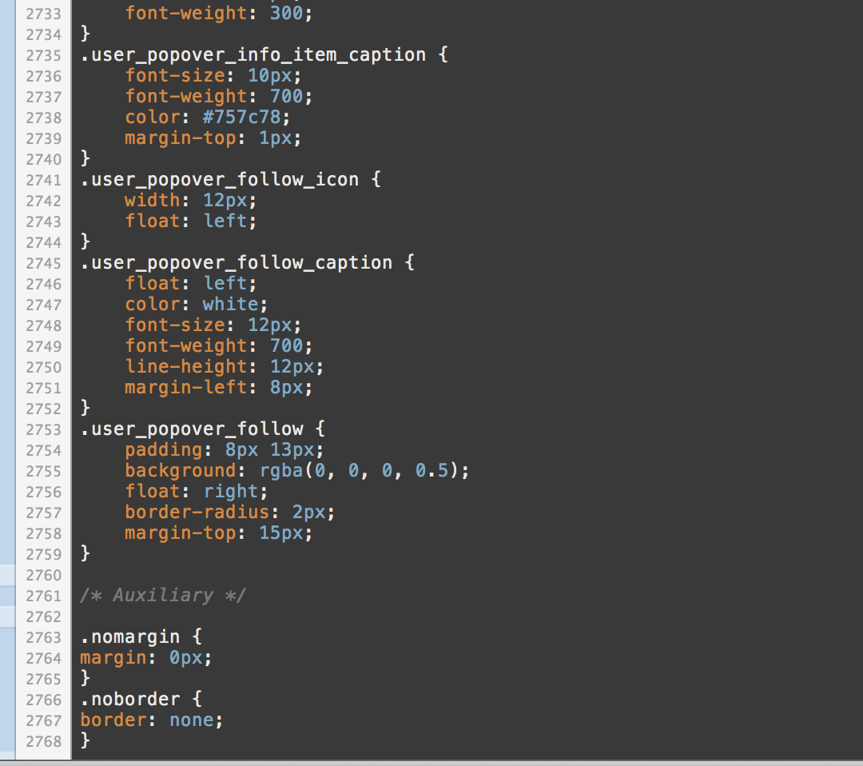
UI Design Workflow
Do I really have to manually type out 2000 lines of CSS?

Slide 35
Web Inspector to the rescue!
Allows you to test your designs in-browser
You can write out CSS rules and see how it looks live
No need to save a file, reload, etc.
Allows you to learn from other people’s work
Other functionalities (for front-end) include:
Autocomplete for CSS rules
Color Picker
Browser Compatibility Test
JS Debugger
3D View (Firefox)

Slide 36
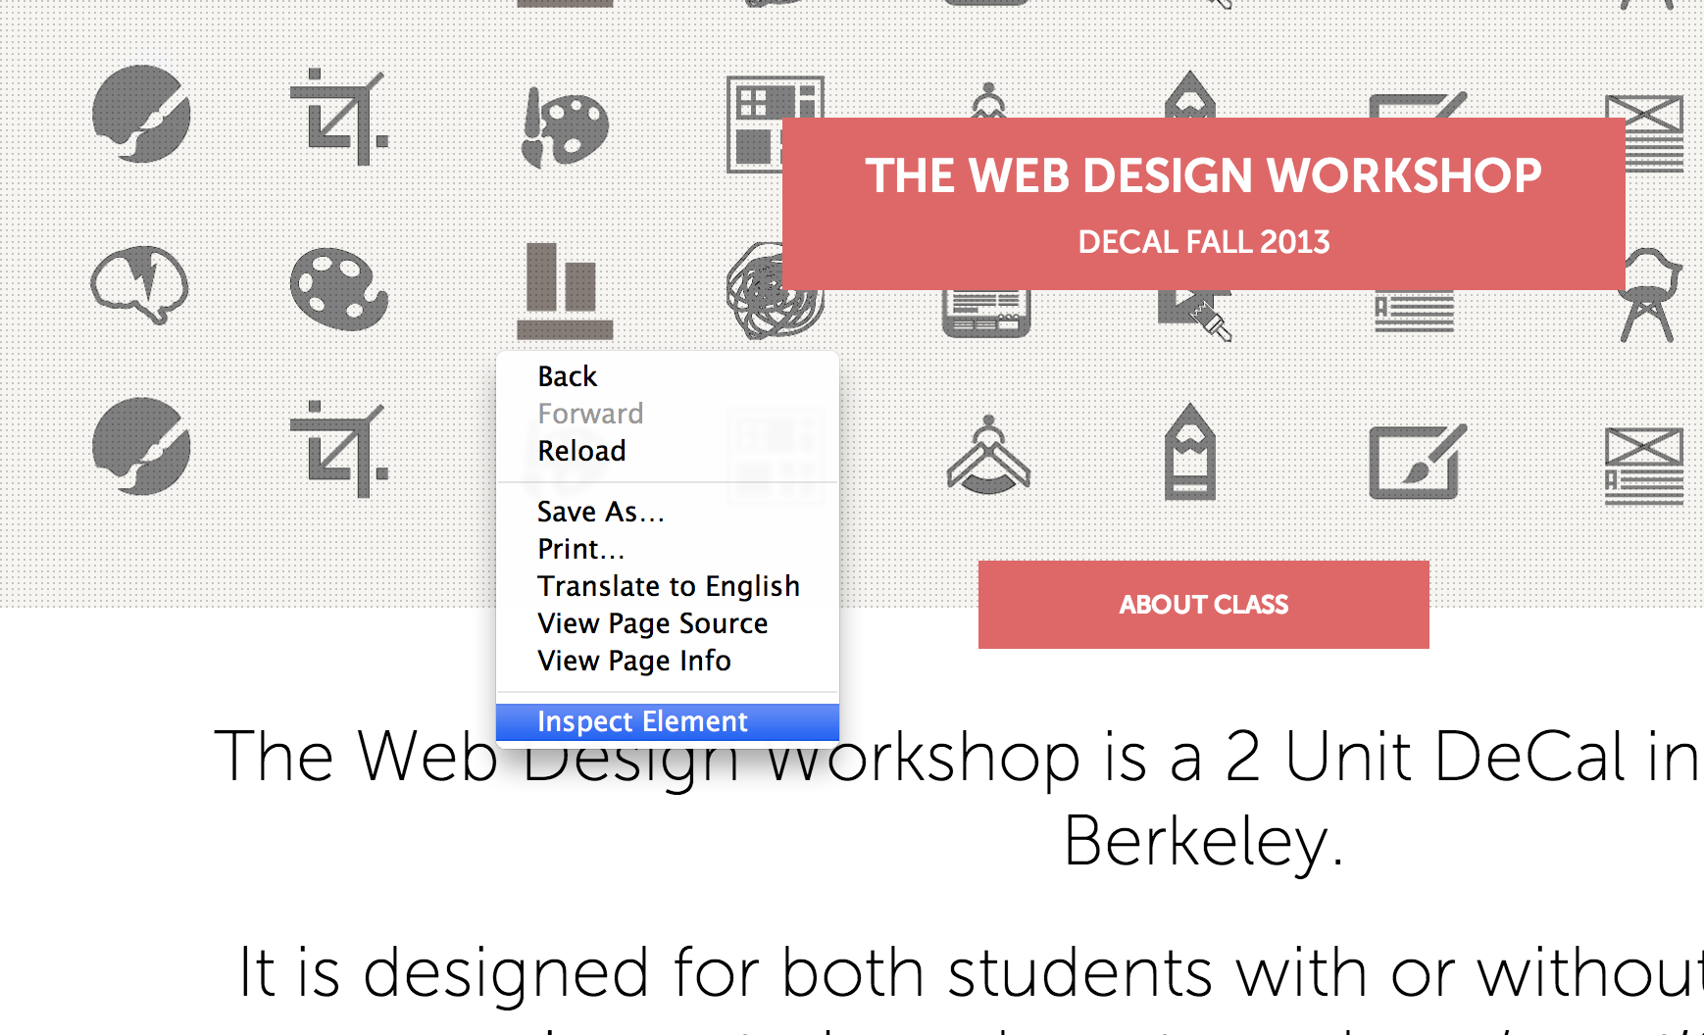
Web Inspector to the rescue!
How to open up Web Inspector

Slide 37
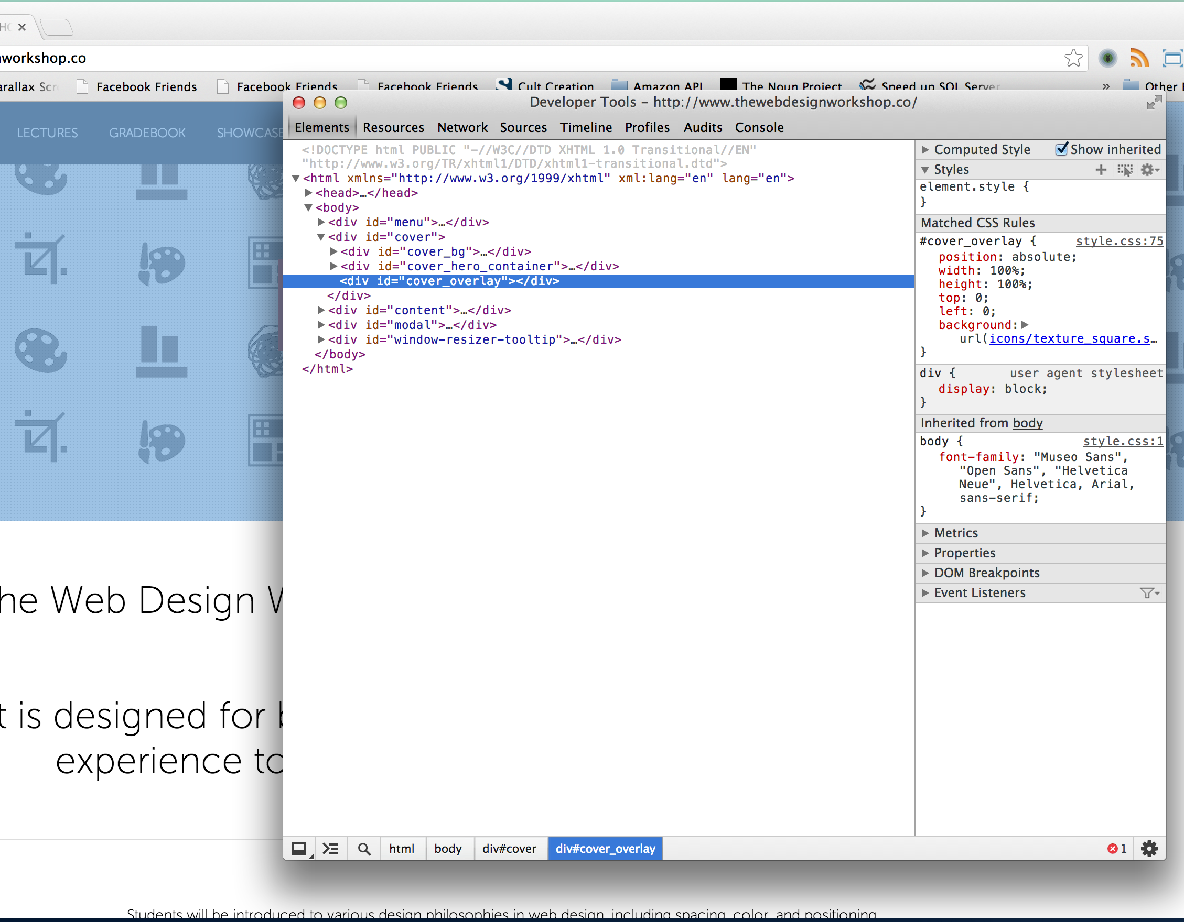
Web Inspector to the rescue!
The selected element is highlighted as Web Inspector opens

Slide 38
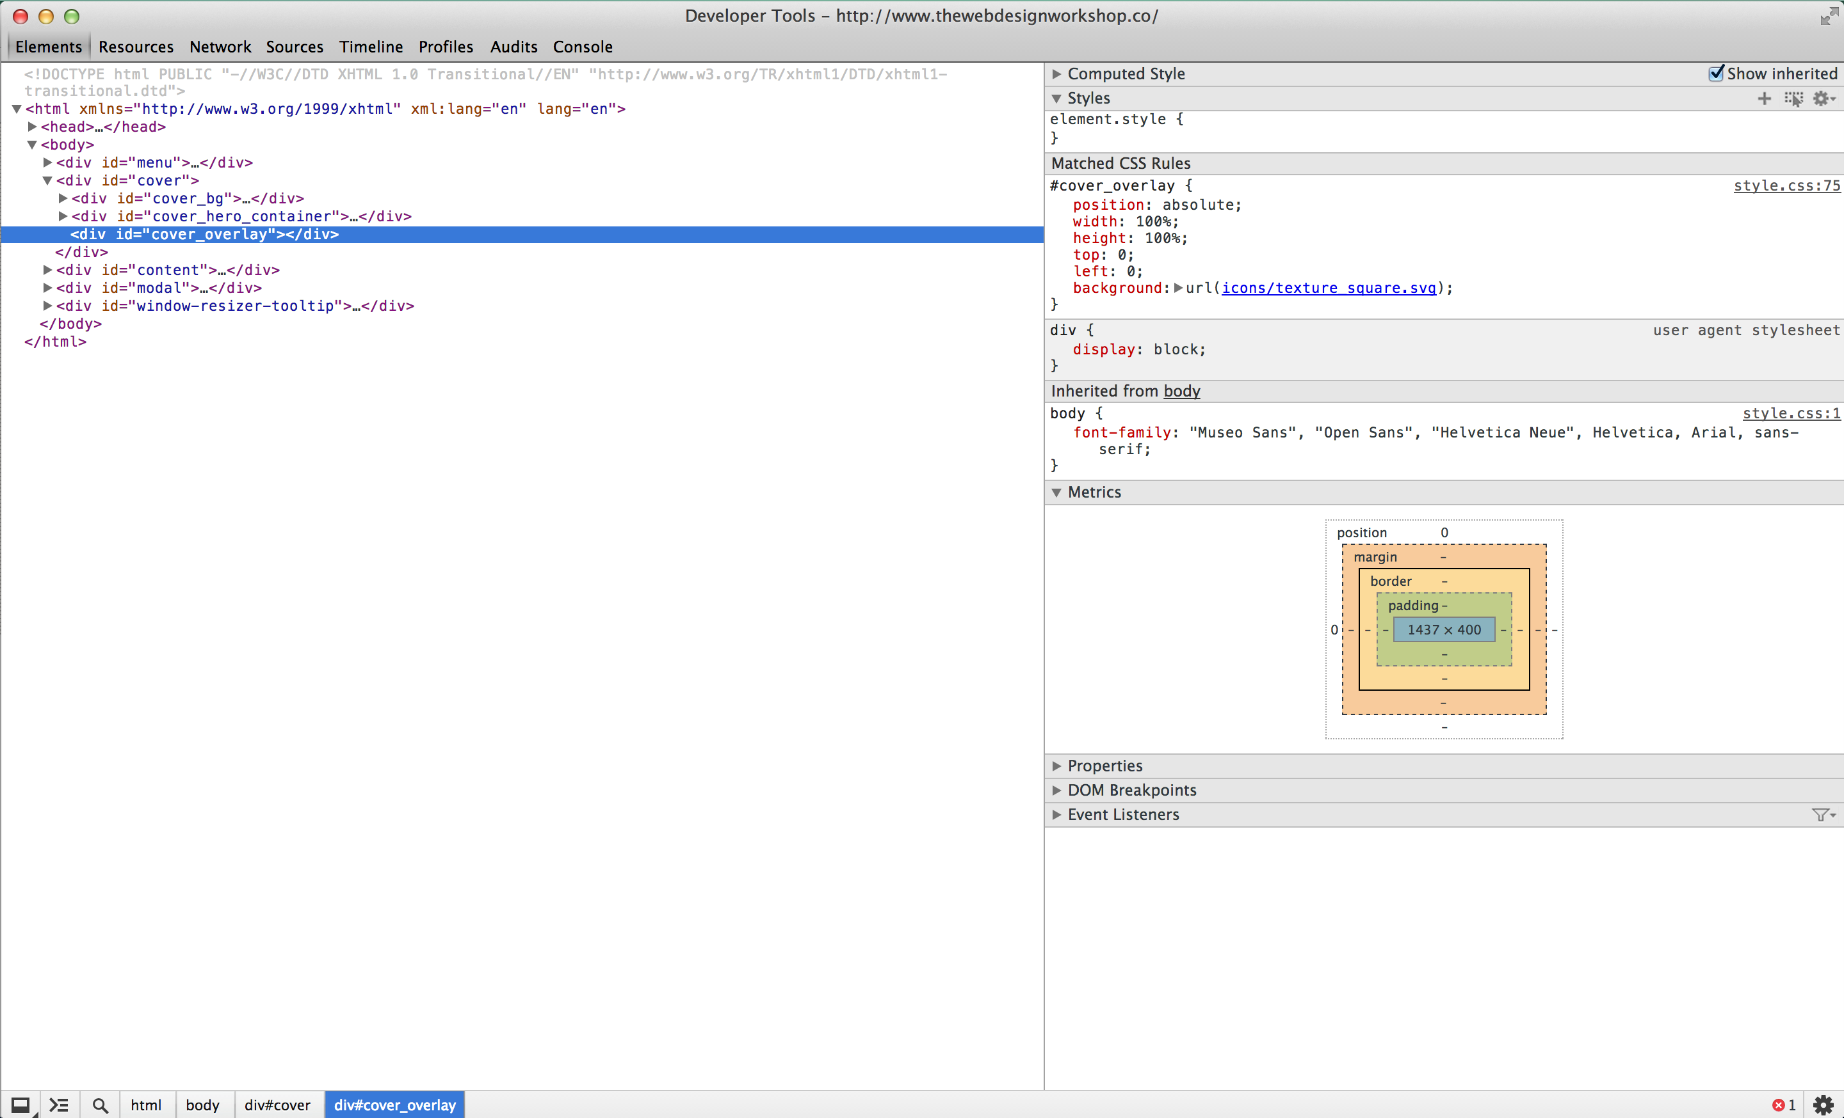
Web Inspector to the rescue!
CSS Editor
Selected Element
Metrics
Elements Tab of the Web Inspector A place for editing web site design on the fly
Notes:
Edit website designs
Peek at other people’s designs
Majority of time here

Slide 39
You will spend as much time on the Web Inspector as you will on the code editor
Try out the code on the Web Inspector before you write it on the Code Editor – It will save you tons of time

Slide 40
Web Inspector Workflow
Open up the Web inspector using “Inspect Element”
Find the element you want to edit, and enter new CSS rules
Fiddle around until it looks good
Take the final code to the Code Editor

Slide 41
A Few Caveats about Web Inspector
Changes you made in web inspector are NOT saved automatically
Must make sure changes are saved manually by:
Going to Resources Tab -> Find your CSS file and copy paste all the code to your CSS file (overwrite)
Going to Resources Tab -> Find inspector-style.css and copy paste all the code to your CSS file (append to end)

Slide 42
More on the Web Inspector next week!

Slide 43
Helpful Resources
Websites to learn web programming
W3Schools (http://www.w3schools.com)
Mozilla WebMaker (http://webmaker.org)
Web Design Showcase
Siteinspire (http://www.siteinspire.com)
Inspire My Web (http://blog.marlonmarcello.com)
Google and Stack Overflow is your biggest (and the best) resource!
If you have any questions, simply search on Google, and you will find an answer 90% of the time
Ex. “How to stack elements horizontally HTML”

Slide 44
For next class (Design)
Introduction to Design Cycle: Prototype, Design, Iterate
Fundamental Rule of UI Design Aesthetics: Emphasis

